Slide 1


Smart Beach by Bruce County
for Sanjeev Kumar
Sanjeev Kumar - Professor
Brunilda Xhaferllari – Project Manager
Rich Freeman – Faculty Mentor
AI Team:
Janvi Patel
Fangji Chen
Scaria Ouseph Kurian
Date: 29-03-2023
Notes:
Image: 12019 (2016) Ocean waves crashing on shore during daytime https://pixabay.com/photos/beach-sea-sunset-sun-sunlight-1751455/

Slide 2
Architecture updates
V3

Slide 3
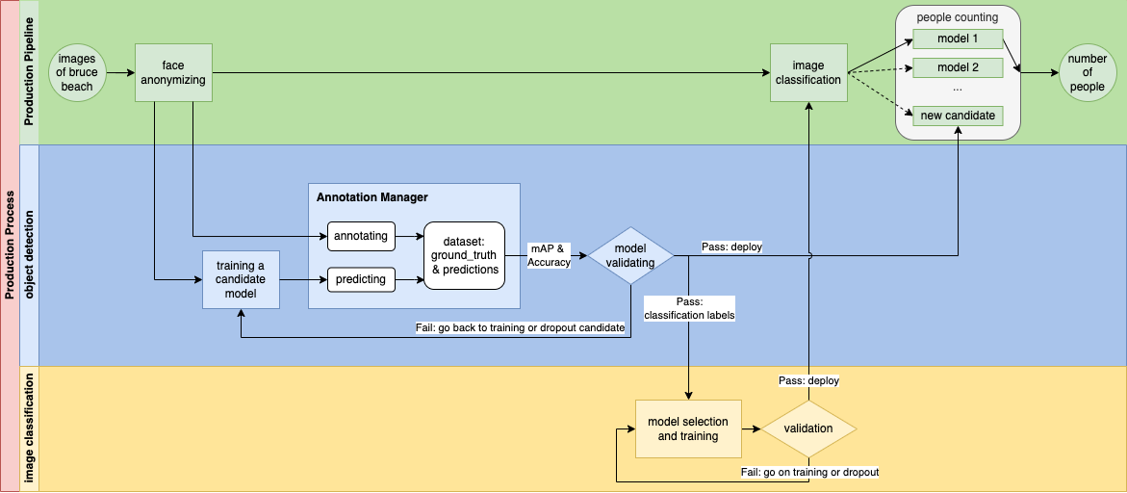

Slide 4
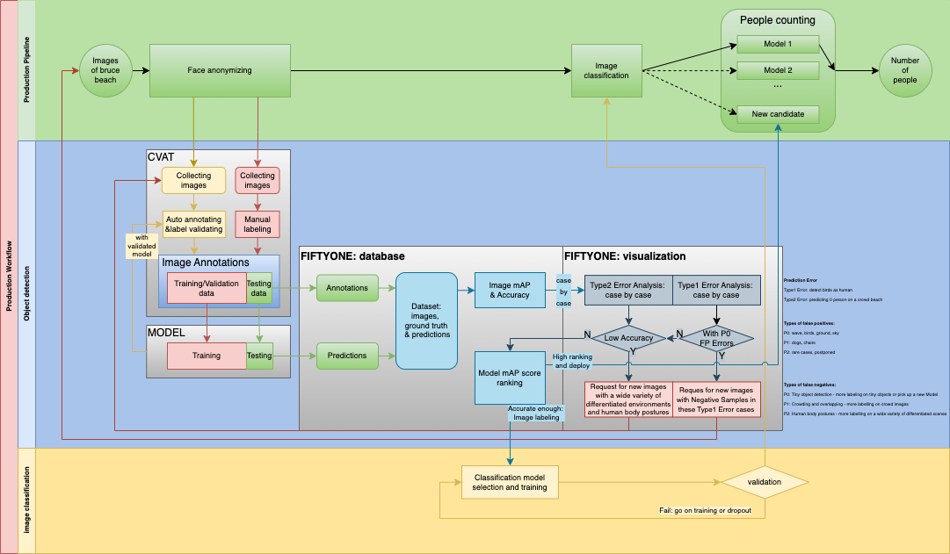

Slide 5
Annotations and Prediction errors
What is a bad case?
P0: wave, birds, ground, sky
P1: dogs, chairs, dead-wood bringing by the storm
P2: rare cases, will be postponed

Slide 6
Compare prediction with annotations
on training & validation datasets.
(Actually, we should use the test dataset instead. But we didn’t prepare enough images for that.)

Slide 7
Correct labeling errors

Slide 8
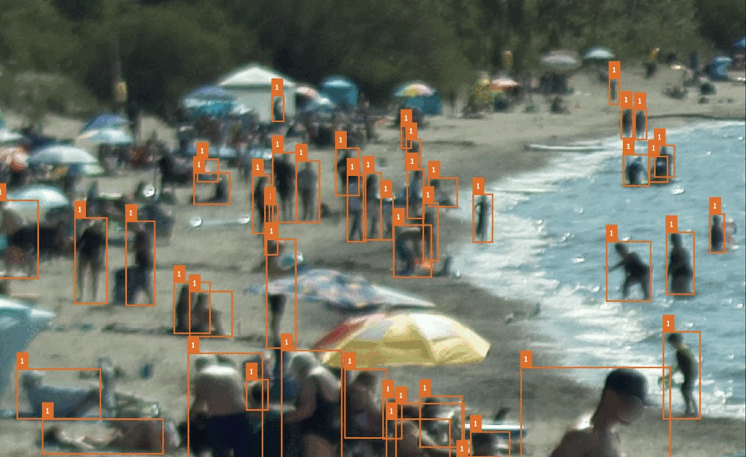
Missed annotations
Bad prediction:
beach umbrella
Bad annotation:
swim ring
Bad prediction:
swim rings

Slide 9
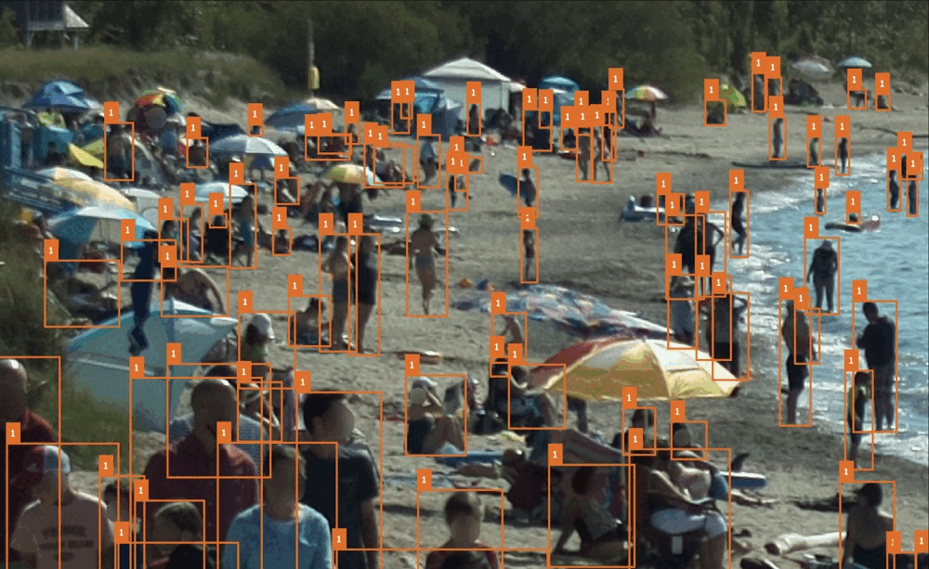
Missed annotations
Bad annotation:
Auto annotating
Bad annotation:
Auto annotating
Bad annotation:
Auto annotating

Slide 10
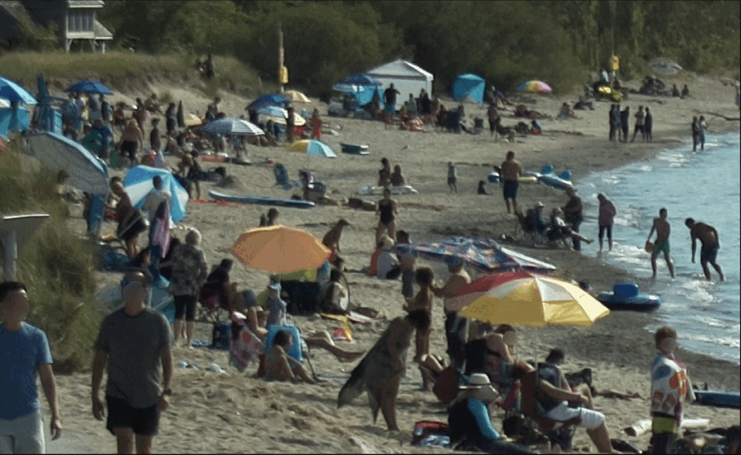
Bad annotation:
Auto annotating
Bad annotation:
dog
Bad annotation:
Crowding
Bad prediction:
Crowding
Bad prediction:
Dog, chair

Slide 11
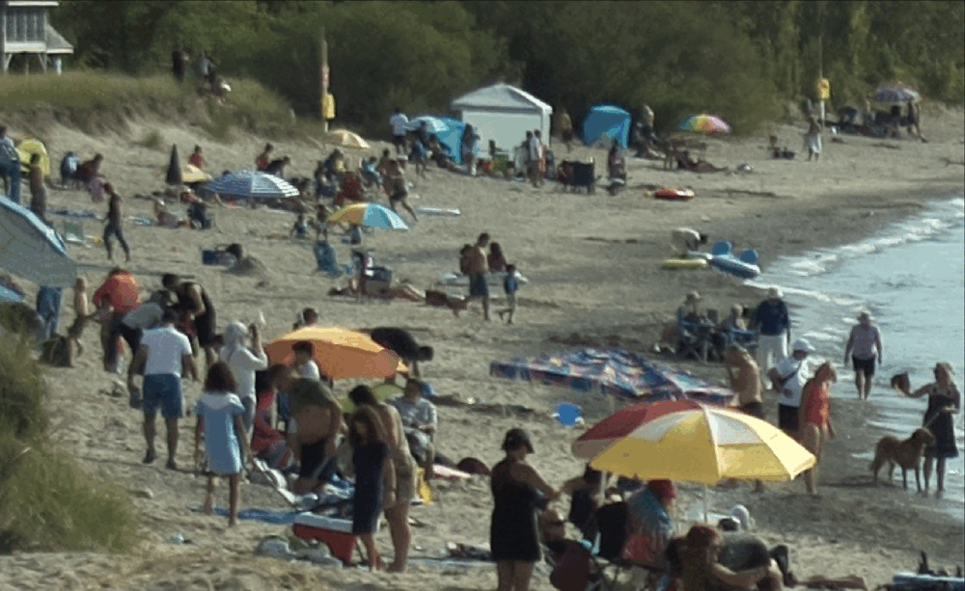
Missing
Bad annotation
Bad annotation
Missing
Bad annotation:
Wrong area of a bounding box
Missing
Bad annotation
Missing

Slide 12
Enlarge training dataset
Introduce more negative samples into training/validating process

Slide 13
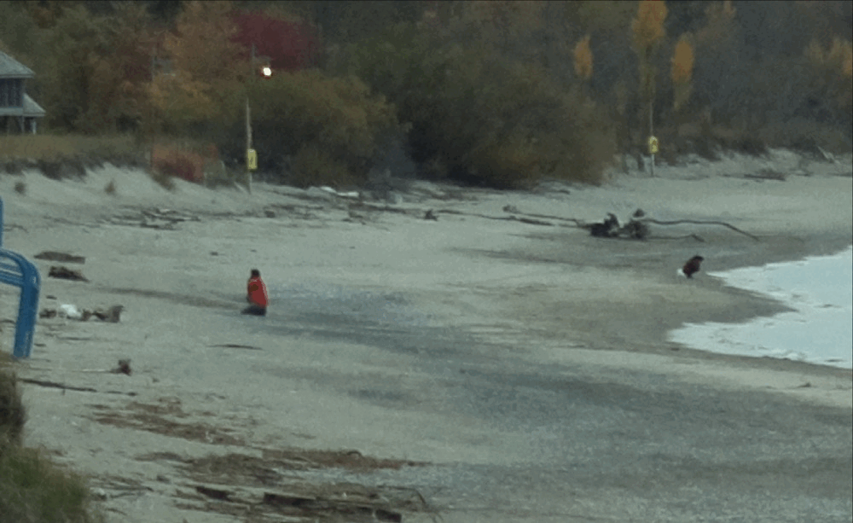
Bad annotation:
Wrong area of a bounding box
Dead-wood
Squatting girl
Dead-wood

Slide 14
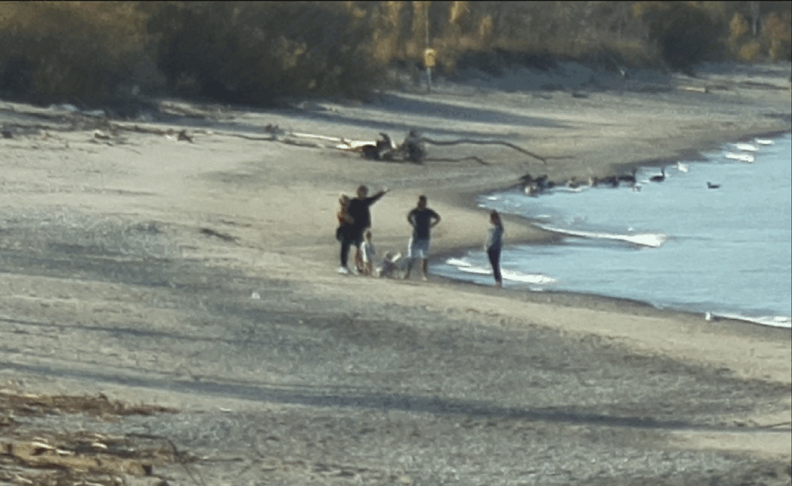
Bad prediction:
recognized a dog as a baby squatting playing sands

Slide 15
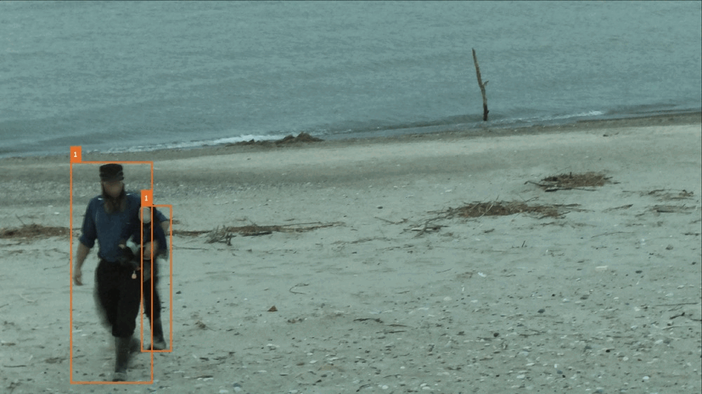
Bad prediction:
Tiny rock

Slide 16
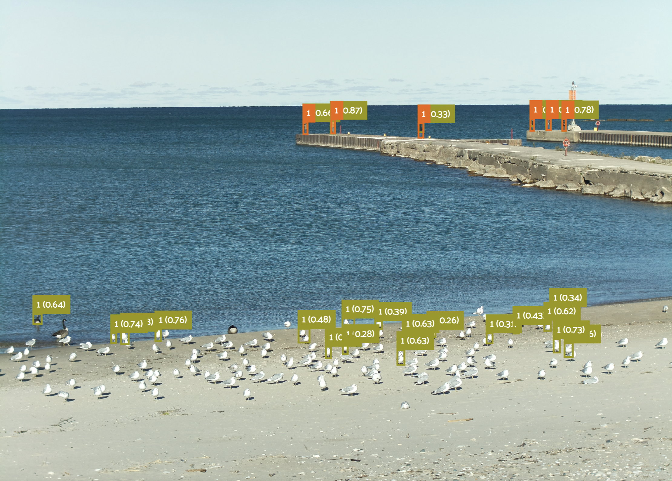
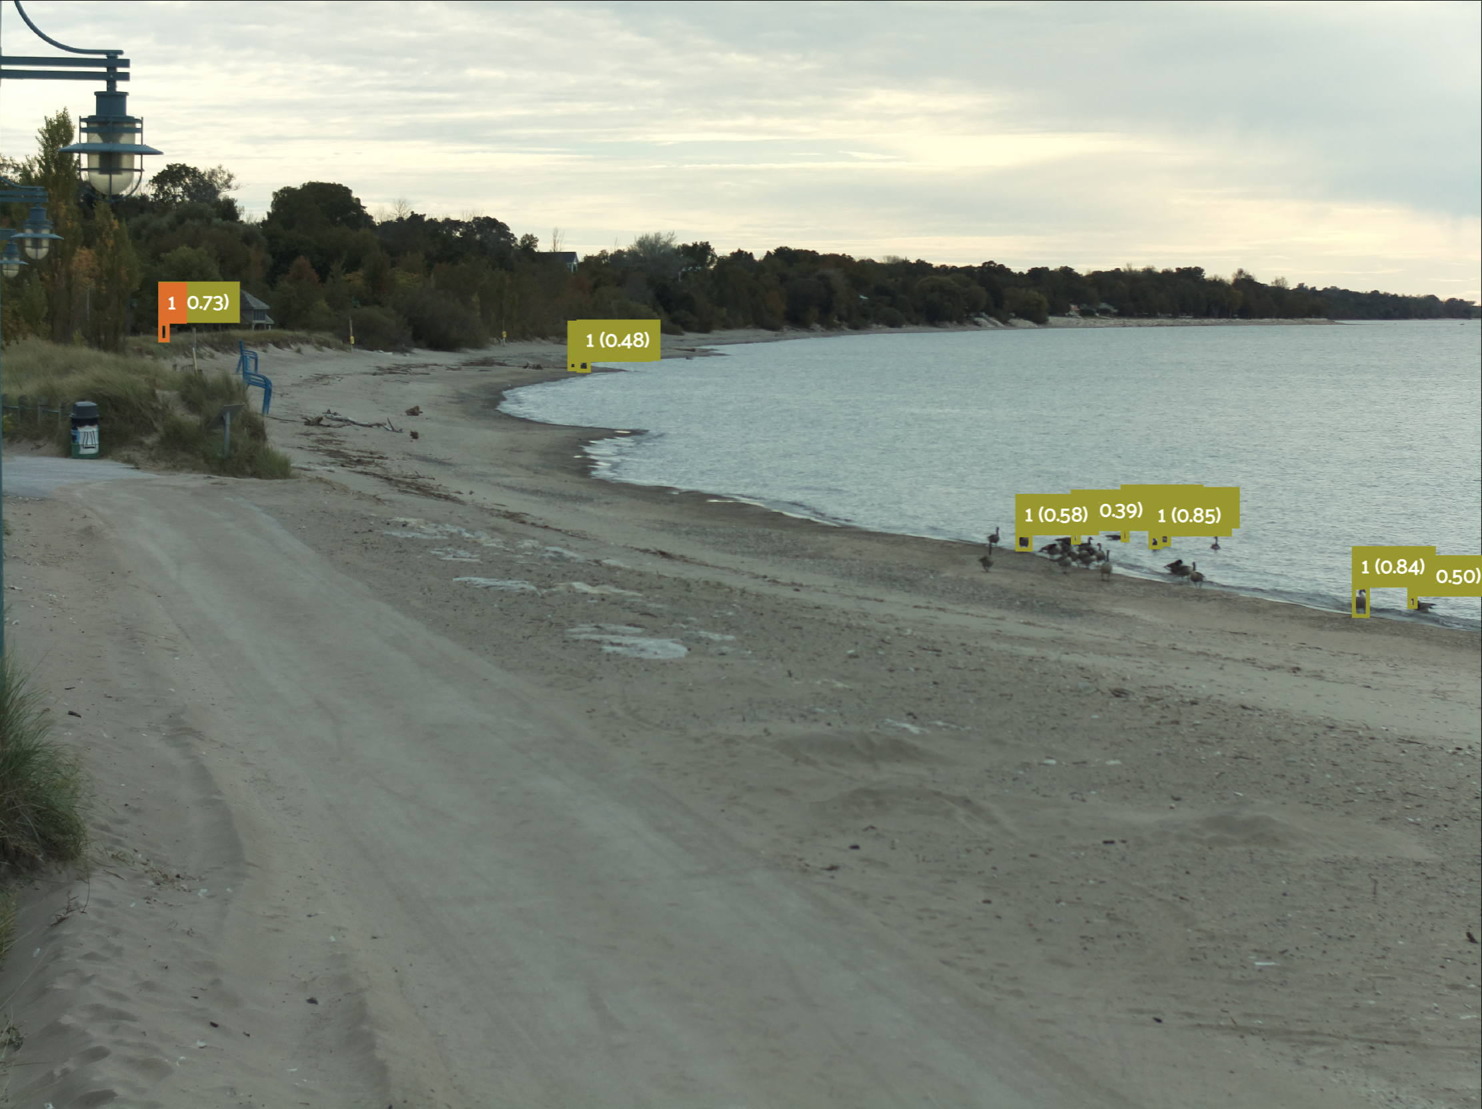
How bad the model performs depends on how empty the shore is...
This is because most of the training data are with crowded people on shore and inshore. A wide range of negative samples is crucial to train a robust model.

Slide 17
Model training

Slide 19
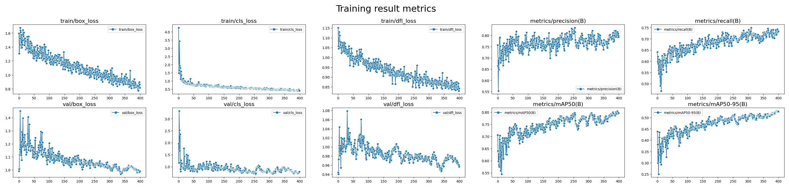
The previous version with false positives in predicting a bird as a person.
Training dataset: 158
Validation dataset: 73
Test dataset: 0
mAP: 0.525

Slide 20
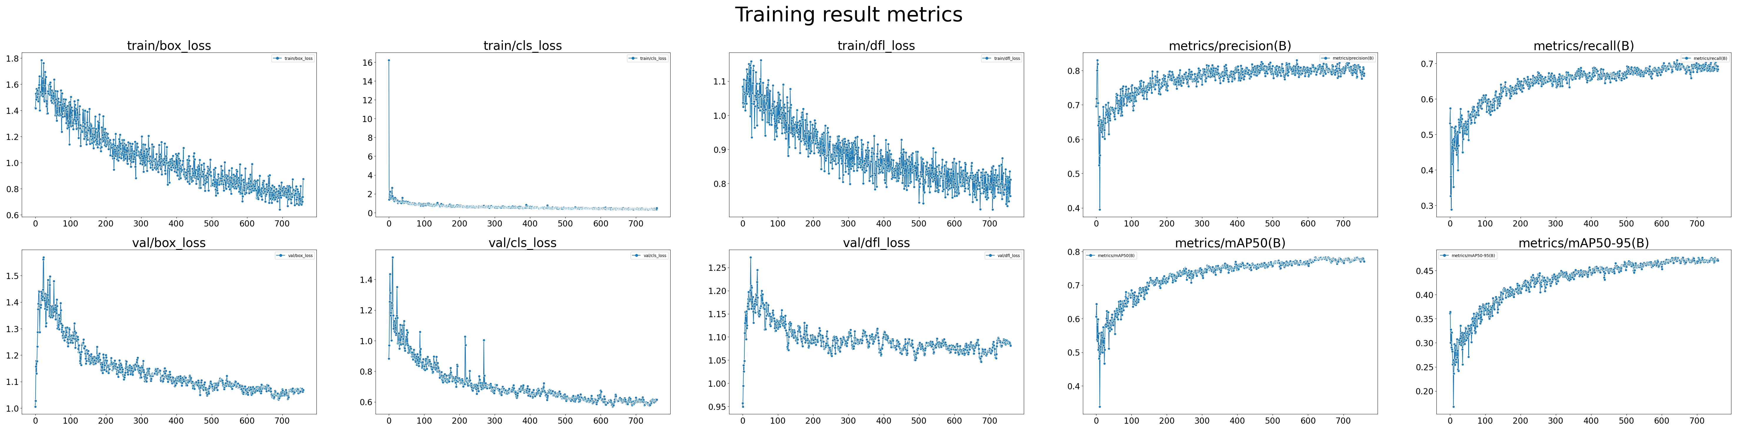
Training dataset: 259, bounding boxes 8009, human density 30.9
Validation dataset: 90, bounding boxes 2676, human density 29.7
Test dataset: 77, bounding boxes 2266 , human density 29.4
Training result: mAP 0.477

Slide 21
Model validating

Slide 22
Get some clues about which image to see and examine by computing image metrics.

Slide 23
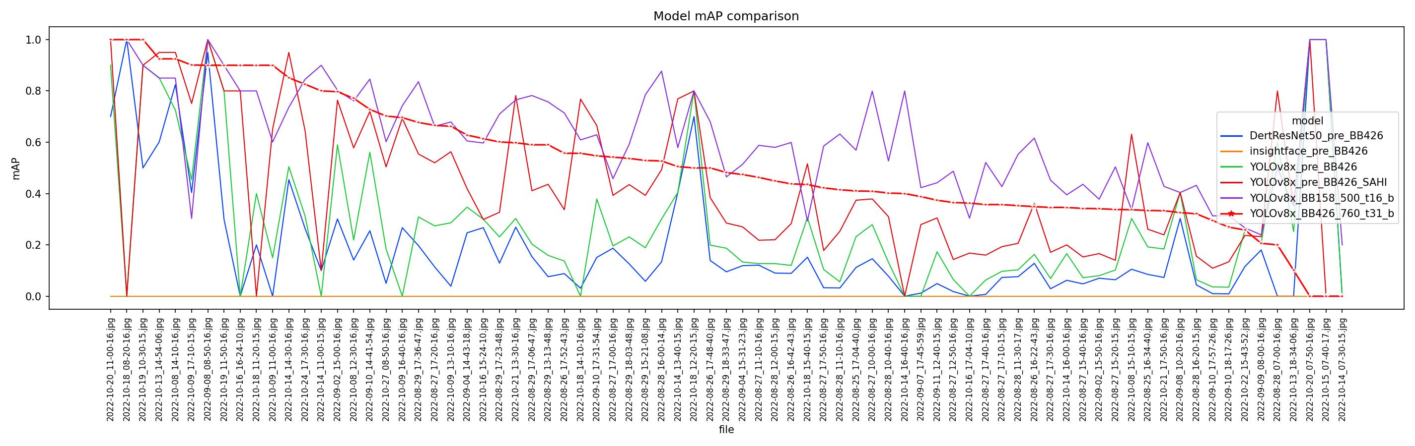
In most of the case, the latest model shows the best accuracy than all the other candidates.
Some bad case are found in this plot due to the reason of the lack of training data: the model needs a wider range of training cases to learn what are the real patterns of people.

Slide 24
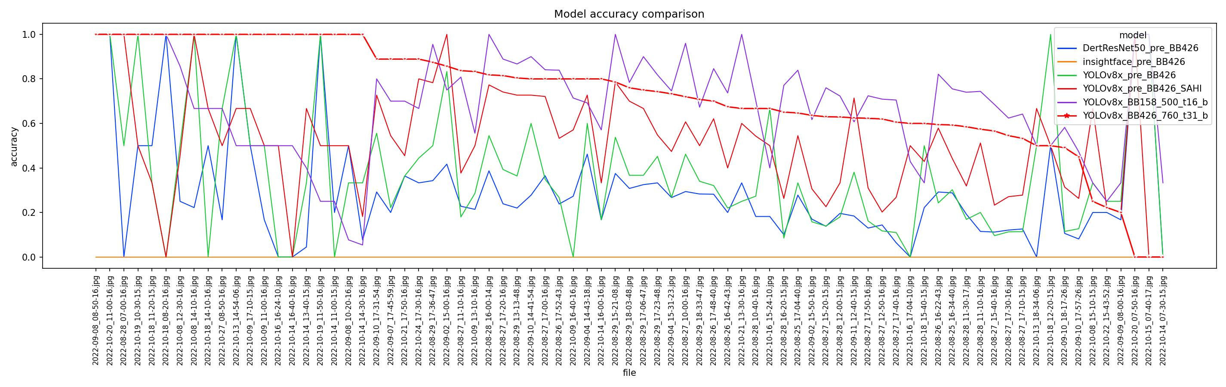
The same issue can be seen in this mAP score metric plot

Slide 25


Slide 26
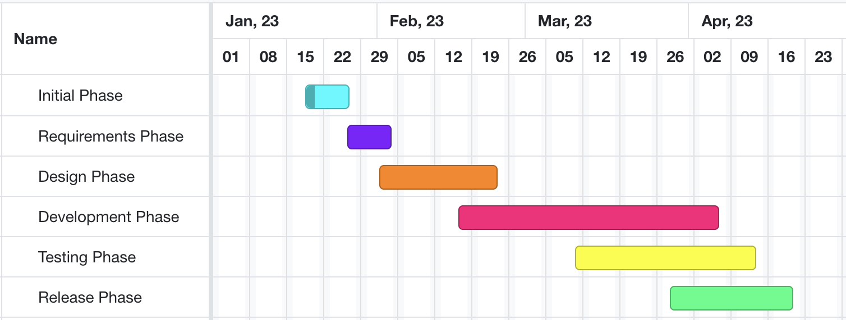
Developing and testing models on beach data
High-level GANTT Chart

Slide 27
Activities to be Completed before Next report:
Final model testing.
Project submission.
Notes:
Olexa, Peter (n.d.) A Person Making a Schedule. Accessed on January 18th, 2023 from https://www.pexels.com/photo/a-person-making-a-schedule-14299948/

Slide 28
Thank you!
Questions?
Notes:
Image: Leloo, The first (2022) https://www.pexels.com/photo/question-marks-on-paper-crafts-5428833/

